Slide 1
Database Development
06 Mar, 2025
1

Slide 2
Course : Amazon Redshift
Lecture On : Database Development
Instructor : Nitin
2

Slide 3
In Last Class, we covered….
01
Overview of DBeaver
02
Connecting to Redshift Cluster using DBeaver
03
Securing the Amazon Redshift cluster connection
04
Monitoring and troubleshooting
3

Slide 4
Poll 1(Answer)
Which of these are categorical variables?
Temperature of an engine
Make of car
Mileage of a car
Rating given by a customer for an Uber ride
Practice in teams of 4 students
Industry expert mentoring to learn better
Get personalised feedback for improvements
4

Slide 5
Today’s Agenda
01
Ingestion
Data distribution and storage
Data models for Amazon Redshift
Data management in Amazon Redshift
Data transformation
Resource management
02
03
04
05
06
5

Slide 6
Ingestion in AWS Redshift
Data Sources:
Streaming data from Amazon Kinesis.
Batch data from S3, RDS, and on-premise systems.
Methods:
COPY command for bulk data ingestion.
Redshift Data API for real-time ingestion.
Integrations with AWS Glue and DMS.
Regression: An Overview

Slide 7
Ingestion in AWS Redshift
Best Practices:
Use columnar file formats like Parquet or ORC.
Compress data to reduce load times.
Validate and clean data before ingestion.
Regression: An Overview
7

Slide 8
Data Distribution and Storage in AWS Redshift
Columnar Storage Architecture:
Data stored in columns for high performance in analytics.
Data Distribution Styles:
AUTO: Default distribution method.
KEY: Data distributed based on a specific column.
ALL: Replicates data on all nodes for smaller datasets.
EVEN: Uniformly distributes data across nodes.
Regression: An Overview
8

Slide 9
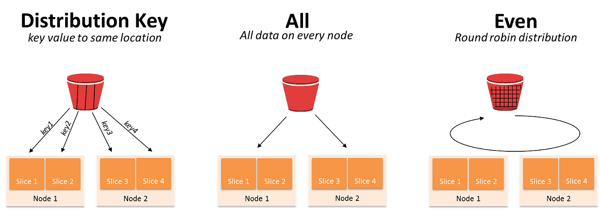
Data Distribution and Storage in AWS Redshift
Regression: An Overview
9

Slide 10
Data Distribution and Storage in AWS Redshift
Best Practices:
Choose distribution keys to minimize data shuffling.
Use compression encoding to reduce storage footprint.
Regression: An Overview
10

Slide 11
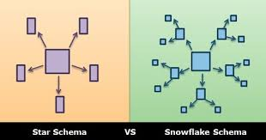
Data Models for Amazon Redshift
Star Schema:
Central fact table surrounded by dimension tables.
Suitable for query performance and simplicity.
Snowflake Schema:
Dimension tables are normalized into sub-dimensions.
Reduces data redundancy.
Regression: An Overview
11

Slide 12
Data Models for Amazon Redshift
Best Practices:
Denormalize data for faster query performance.
Avoid using multiple joins to reduce query complexity.
Regression: An Overview
12

Slide 13
Data Management in Amazon Redshift
Monitoring and Maintenance:
Amazon CloudWatch for performance monitoring.
VACUUM command to reclaim storage.
ANALYZE command to update statistics for query optimization.
Snapshots and Backups:
Automated and manual snapshots.
Restores in minutes with minimal downtime.
Scaling:
Elastic resize for scaling clusters.
Regression: An Overview
13

Slide 14
Data Transformation
ETL (Extract, Transform, Load):
Transform data with SQL or AWS Glue before loading.
ELT (Extract, Load, Transform):
Load raw data and transform using Redshift SQL capabilities.
Tools:
AWS Glue, Amazon EMR, and third-party tools like dbt.
Best Practices:
Use staging tables for intermediate transformations.
Optimize transformations using SORT and DIST keys.
Regression: An Overview
14

Slide 15
Resource Management
Workload Management (WLM):
Create separate queues for high-priority workloads.
Assign memory and concurrency limits to queues.
Concurrency Scaling:
Add transient clusters to handle peak loads.
Redshift Spectrum:
Query data directly from S3 without moving it to Redshift.
Regression: An Overview
15

Slide 16
Resource Management
Best Practices:
Monitor query performance with Query Monitoring Rules.
Use audit logs to track user activities.
Regression: An Overview
16

Slide 17
Knowledge Check
Which of the following is the most common command for loading large volumes of data into Amazon Redshift?
A) INSERT
B) COPY
C) LOAD
D) PUT

Slide 18
Knowledge Check
Which of the following is the most common command for loading large volumes of data into Amazon Redshift?
A) INSERT
B) COPY
C) LOAD
D) PUT

Slide 19
Knowledge Check
Which distribution style should you use in Amazon Redshift if you have a large table with frequent joins on a specific column?
EVEN
ALL
KEY
AUTO

Slide 20
Knowledge Check
Which distribution style should you use in Amazon Redshift if you have a large table with frequent joins on a specific column?
EVEN
ALL
KEY
AUTO

Slide 21
Knowledge Check
Which data modeling approach is most commonly used in Amazon Redshift for data warehousing?
Relational Model
Star Schema
Graph Model
Document-Based Model

Slide 22
Knowledge Check
Which data modeling approach is most commonly used in Amazon Redshift for data warehousing?
Relational Model
Star Schema
Graph Model
Document-Based Model

Slide 23
Knowledge Check
Which of the following is the primary method for reclaiming storage after performing DELETE or UPDATE operations in Amazon Redshift?
Compression
VACUUM
Snapshot
Replication

Slide 24
Knowledge Check
Which of the following is the primary method for reclaiming storage after performing DELETE or UPDATE operations in Amazon Redshift?
Compression
VACUUM
Snapshot
Replication

Slide 25
KEY TAKEAWAY
Batch vs. Real-Time: Redshift primarily handles batch processing for large-scale data ingestion, though streaming data can be ingested through tools like Amazon Kinesis or AWS Glue.
01
Data Sources: Data can be ingested from various sources, including Amazon S3, DynamoDB, or directly from an on-premise database via a migration tool.
02
Optimization: To improve performance, leverage parallel loading and ensure data is pre-processed or optimized (e.g., compressed) before loading.
03

Slide 26
NEXT CLASS
Cluster Operations
Viewing Cluster Information
Cluster Relocation
Management Interfaces
Performance Optimization
01
02
03
04
05

